Slide 1
Help Me with my mood
PROJECT NAME
BY Manohar Kumar & Mehul Rastogi

Slide 2
There it is in your Facebook timeline or Instagram gallery – a digital footprint of your mental health.
t’s not hidden in the obvious parts: the emojis, hashtags and inspirational quotes. Instead, it lurks in subtler signs that, unbeknownst to you, may provide a diagnosis as accurate as a doctor’s blood pressure cuff or heart rate monitor.
For those who see social media mainly as a place to share the latest cat video or travel snap, this may come as a surprise. It also means the platform has important – and potentially life-saving – potential. In the US alone, there is one death by suicide every 13 minutes. Despite this, our ability to predict suicidal thoughts and behaviour has not materially improved across 50 years of research. Forecasting an episode of psychosis or emerging depression can be equally challenging.
But data mining and machine learning are transforming this landscape by extracting signals from dizzying amounts of granular data on social media. These methods already have tracked and predicted flu outbreaks. Now, it’s the turn of mental health.
Studies have found that if you have depression, your Instagram feed is more likely to feature bluer, greyer, and darker photos with fewer faces. They’ll probably receive fewer likes (but more comments). Chances are you’ll prefer the Inkwell filter which converts colour images to black and white, rather than the Valencia one which lightens them.

Slide 3
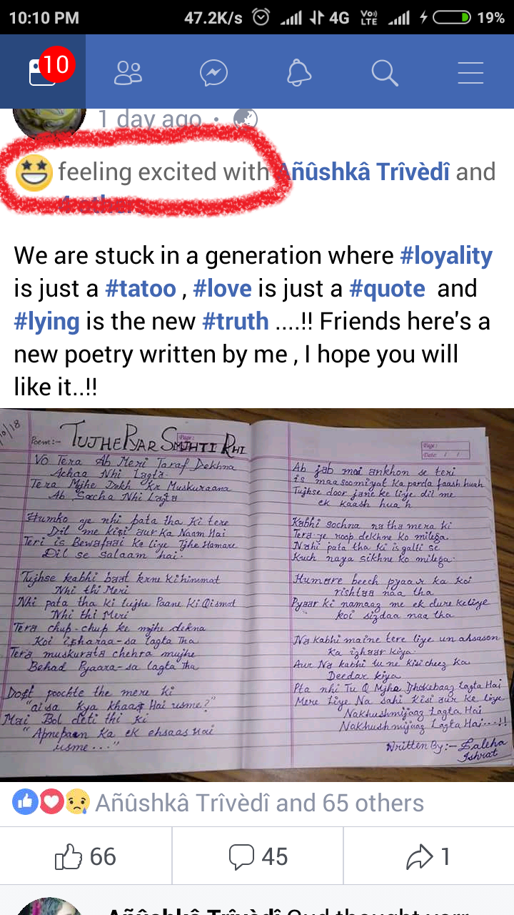
By using social media
By analyzing social media we found that people usually upload the pics and wrote FEELINGS/ACTIVITY .
BY analyzing FEELINGS/ACTIVITY :
eg.

Slide 4
By knowing there moods
According to there moods we can make happy or optimistic.
By knowing there mood we can also save there lives .

Slide 5
APPLICATION (IN PROCESS UPLOAD SOON)
IDEA : BY KNOWING THERE MOODS
THE MAIN THING IS THAT CHANGE THERE MOOD BY SEEING VIDEOS AND LISENING SONGS .
WE ANALYSIS THERE MOOD BY REGISTER PEOPLE AND HELP THEM OUT FROM BAD MOODS.

Slide 6
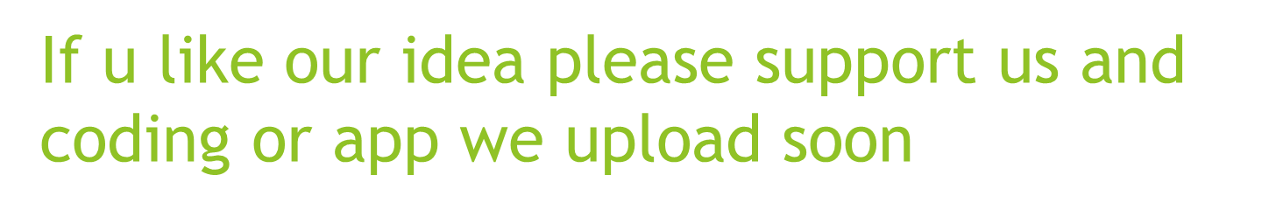
BY Manohar Kumar Mehul Rastogi

